Slide 1



TEAM 9 Trinh Ngoc Minh Tran Duc Anh(leader) Nguyen Hoang Phat Nguyen Huy Hoang
Here is where your presentation begins

Slide 2

TABLE OF CONTENTS
01
02
03
04
Section A
Section B
Problems in managing coffee house
Solutions and introduce my app
Section C
Section D
Demo app
Q&A

Slide 3


ABOUT US
CO
FF
EE

Slide 4





Slide 5

01
SECTION A
Problems in managing coffee house

Slide 6

Problems
Do you know what problems in managing coffee house without technology:
Most of them operate manually, leading to non-scientific and strict management.
Difficult to control exact the number of customers coming.
Staff easily cheat
So we need some solutions to resolve these problems

Slide 7
02
SECTION B
Solutions and introduce my app

Slide 8

SOLUTIONS
Use technology to manage coffee house in a scientific way.
Convenient
Easily to manage staffs and products
Save
Save money and time
Customer insight
Customer’s data

Slide 9
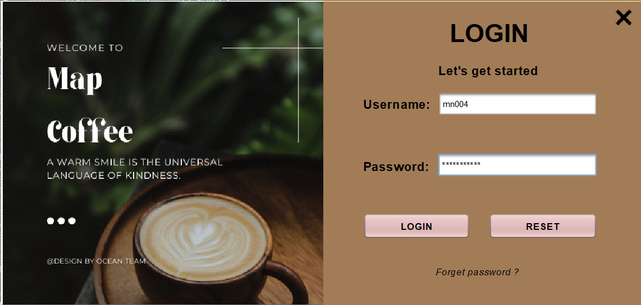
—INTRODUCE APP

Slide 10

PROGRESS
1/4/2022
Planning to build app (functions, database, design)
5/4/2022
Implement functions, set up database, create design
4/5/2022
Complete app, write a report, prepare for the presentation

Slide 11
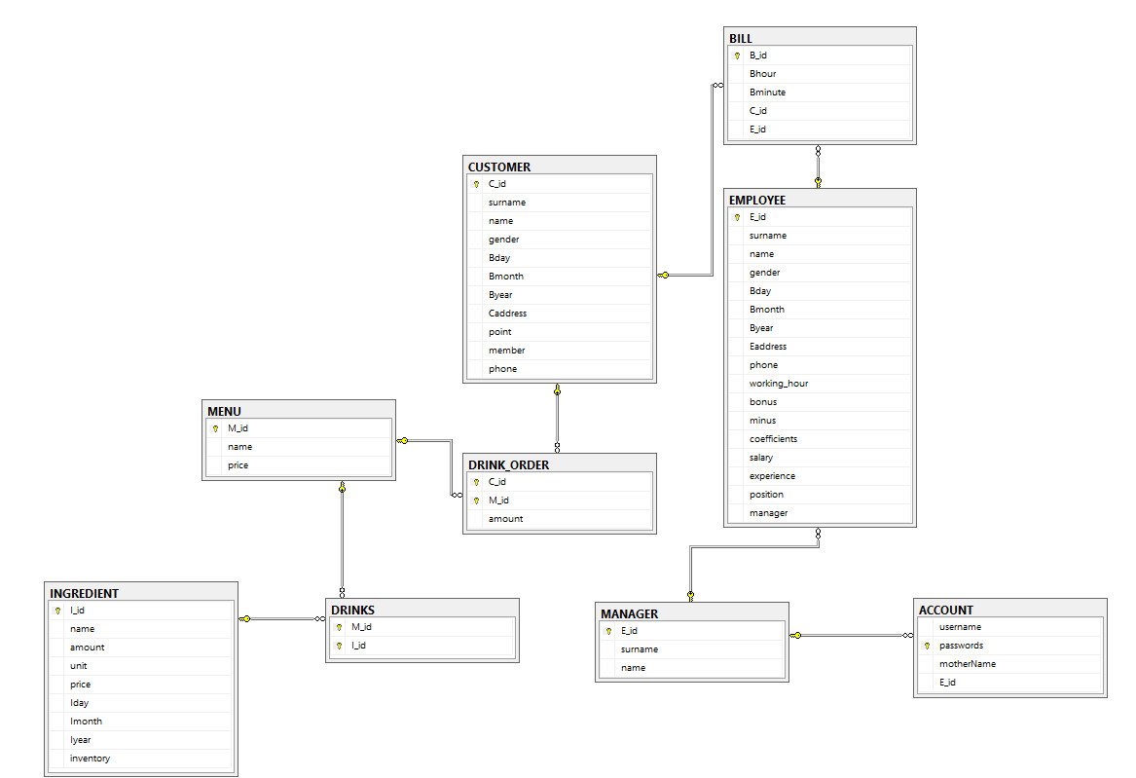

Slide 12
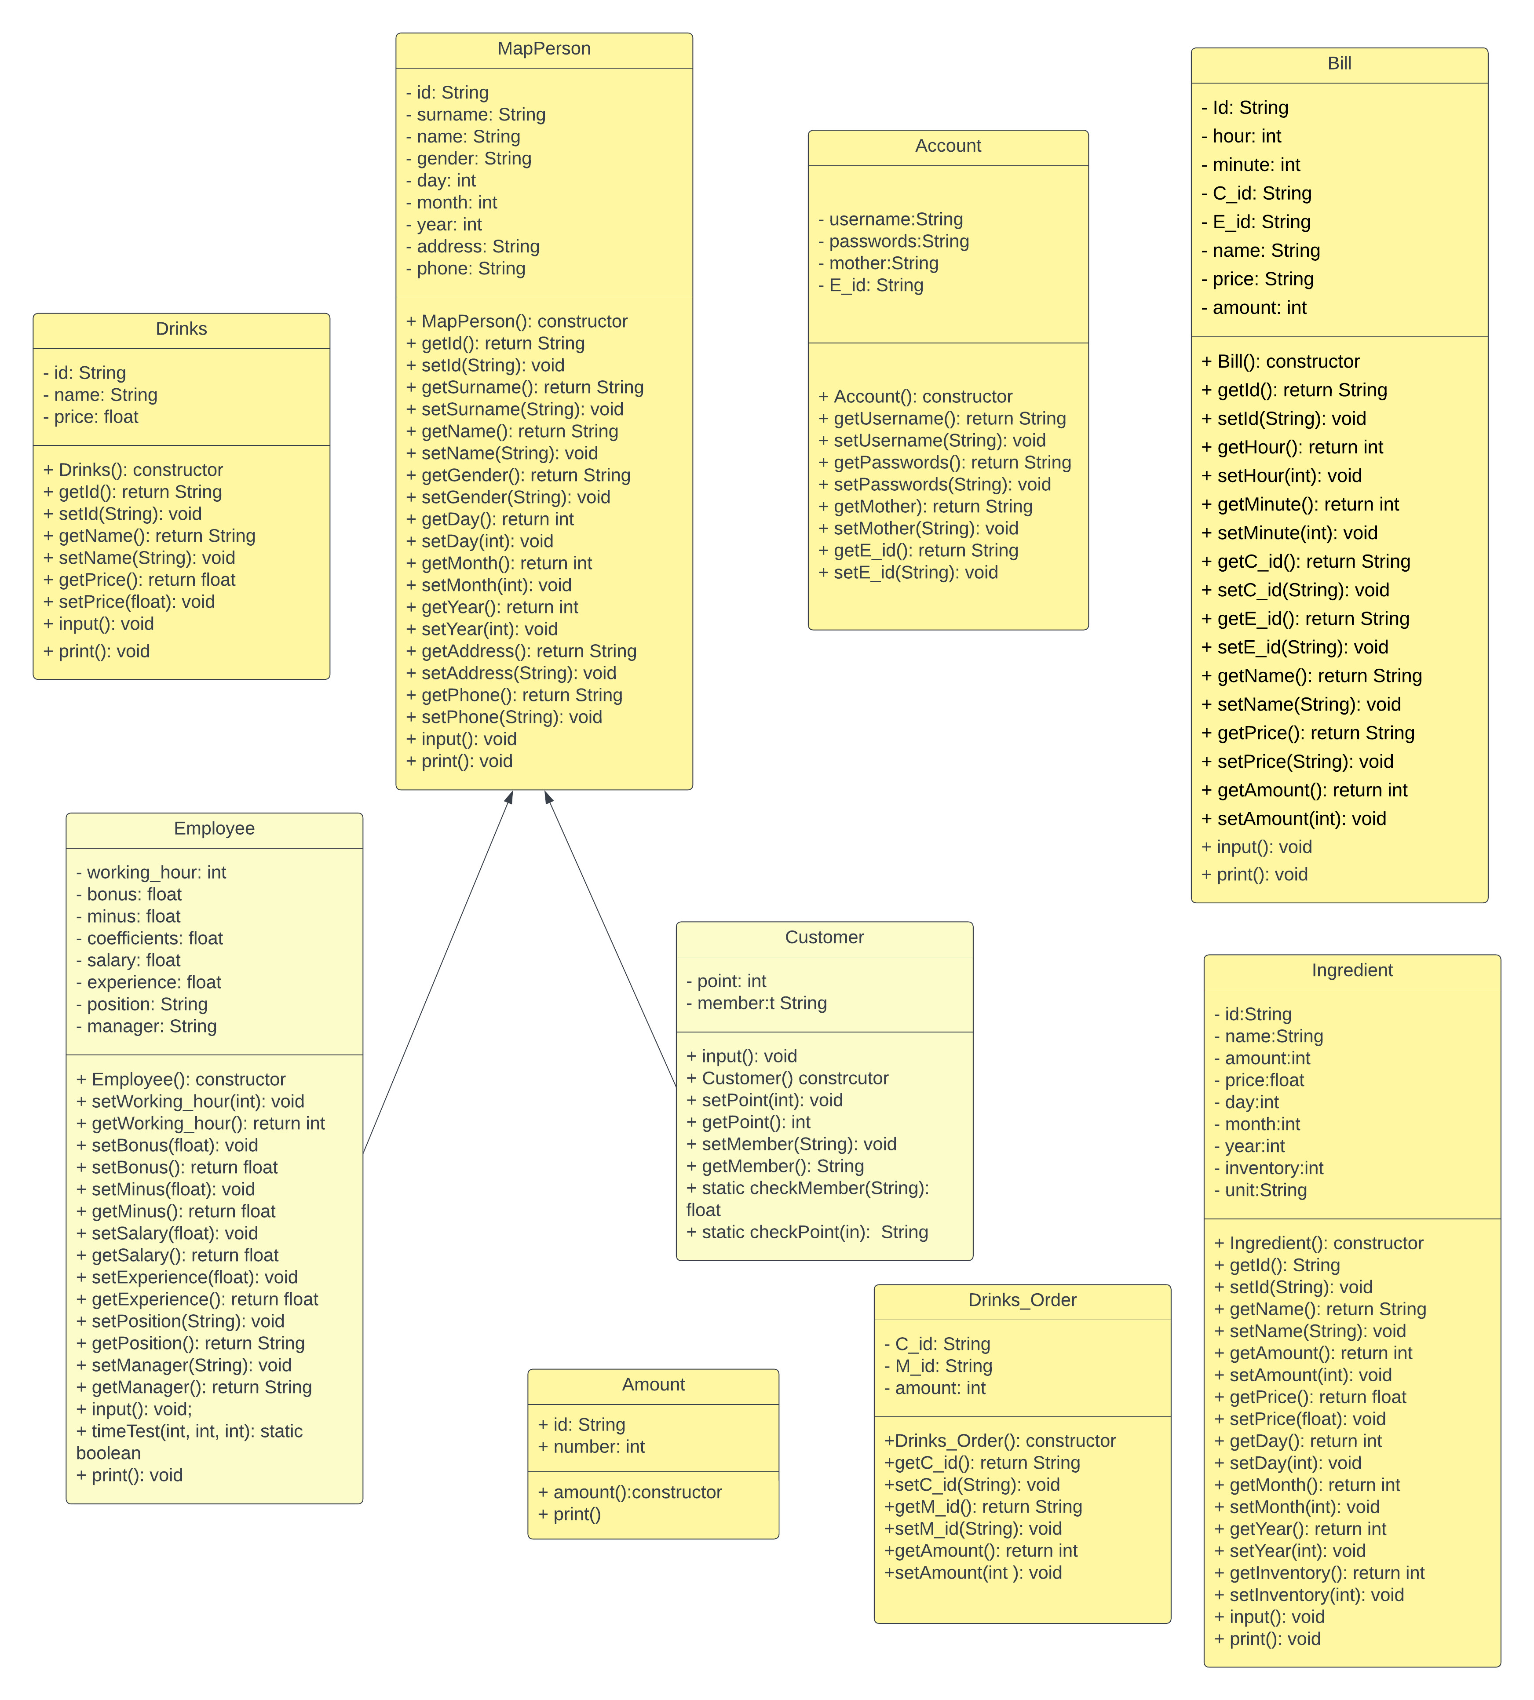

Slide 13





TOOL AND ENVIRONMENT
ECLIPSE
GITHUB
Implement functions
Store code
NETBEANS
SQL SERVER
Create design
Set up database

Slide 14

FUNCTIONS
CASHIER
STAFF
PRODUCT
CUSTOMER

Slide 15

STRENGTHS
SIMPLE
SAVE
Easy to use
Cheap

Slide 16
03
SECTION C
Demo app

Slide 17

A PICTURE IS WORTH A THOUSAND WORDS

Slide 18
04
SECTION D
Q & A

Slide 19

THANKS
MA
PC
AF
E.
DO YOU HAVE ANY QUESTIONS?
teamocean@gmail.com
0123456789
mapcoffee.com
GOOD BYE

